Slide 1

Databases Basics
How Do Relational Database Management System Work?
SoftUni Team
Technical Trainers
Software University
http://softuni.bg

Slide 2
Table of Contents
Database Management
SQL vs NoSQL
Database Engine
Structured Query Language (SQL)
MySQL
NoSQL and MongoDB

Slide 3
Have a Question?
sli.do
#tech-common

Slide 4

Database Management
When Do We Need a Database?

Slide 5
What is Database?
A database is a collection of information that is organized so that it can be easily accessed, managed and updated
Modern databases are managed using a Database Management System (DBMS)
Define database structure, e.g. tables, columns, relations
Create / Read / Update / Delete data (CRUD operations)
Execute queries (search)

Slide 6
Database Management System
A Database Management System (DBMS) is a software used to define, manipulate, retrieve and manage data in a database
DBMS generally manipulates the data itself, the data format, field names, record structure and file structure
Some other DBMS examples include:
MySQL
MS SQL Server
Oracle

Slide 7


Storage vs. Management
Conventional Data Storage
Notes
Receipts

Slide 8

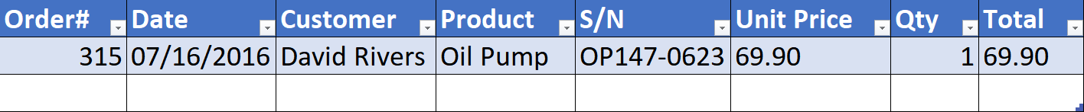
Storage vs. Management (2)
We can group related pieces of data into separate columns

Slide 9

Storage vs. Management
Storing data is not the primary reason to use a Database
Flat storage eventually runs into issues with:
Size
Ease of updating
Ease of searching
Accuracy
Security
Redundancy
Importance

Slide 10
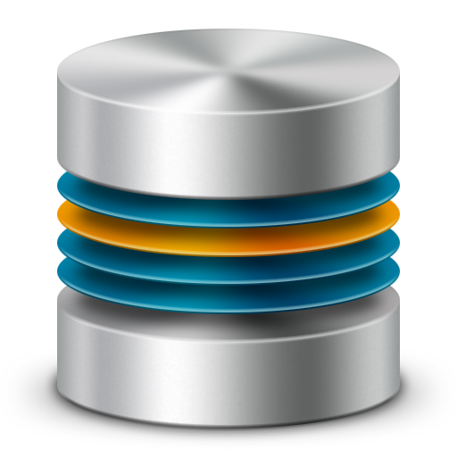
SQL vs. NoSQL Databases

Slide 11
SQL Databases (Relational Databases)
Relational (SQL) databases use structured query language (SQL) for defining and manipulating data
This is extremely powerful:
SQL is one of the most versatile and widely-used options available
Making it a safe choice and especially great for complex queries
On the other hand, it can be restrictive

Slide 12
SQL Databases (Relational Databases) (2)
Relational DB model organizes data into one or more tables of columns and rows with a unique key identifying each row and foreign keys defining relationships
Item ID | Order ID | Item | Amount
5 | 1 | Table | 200.00
6 | 1 | Chair | 123.12
Customer ID | Name | Email
5 | Peter | peter@gmail.com
6 | Jayne | jayne@gmail.com
Order ID | Customer ID | Date | Amount
1 | 5 | 11/1/17 | 323.12
2 | 1 | 11/15/17 | 13.99

Slide 13
NoSQL Databases (Non-Relational Databases)
A NoSQL database, has dynamic schema for unstructured data
Data is stored in many ways:
Can be column-oriented
Document-oriented
Graph-based
Organized as a key-value store
You can read more here

Slide 14
Scalability
SQL are vertically scalable
Which means that you can increase the load on a single server by increasing things like CPU, RAM or SSD
NoSQL are horizontally scalable
This means:
You handle more traffic by sharding
Adding more servers in your NoSQL database

Slide 15
Structure
SQL databases are table-based
Better option for:
Applications that require multi-row transactions - such as an accounting system
For legacy systems that were built for a relational structure
NoSQL databases have four main types of databases:
Wide-Column Store
Document Store
Key-Value Data Store
Graph Store

Slide 16
Databases Examples
SQL databases include:
MySQL
Oracle
PostgreSQL
Microsoft SQL Server
NoSQL database include:
MongoDB
BigTable
Redis
RavenDB
Cassandra
HBase

Slide 17
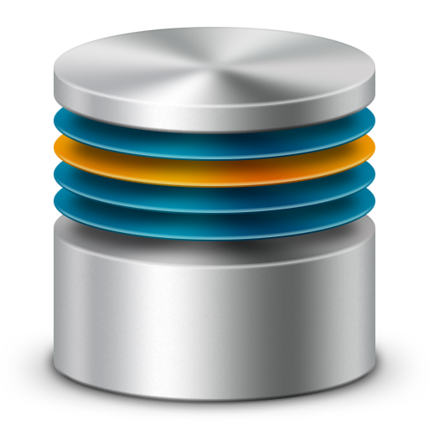

Database Engines
Client-Server Model

Slide 18





Database Engine Flow
SQL Server uses the Client-Server Model
Clients
Query
Engine
Access
Database
Data
Data

Slide 19


Server Architecture
Logical Storage
Instance
Database / Schema
Table
Physical Storage
Data Files and Log Files
Data Pages
Instance
Database (Schema)
Database
(Schema)
Table
Table
Database
(Schema)
Table
Table
Data
Logs

Slide 20
Database Table Elements
The table is the main building block in the relational databases
Each row is called a record or entity
Columns (fields) define the type of data they contain
Column
CustomerId | FirstName | Birthdate | CityId
1 | August | 03/12/1975 | 101
2 | Bejnamin | 04/04/1984 | 102
3 | Denis | 15/10/1988 | 103
4 | Linda | 07/01/1984 | 104
Row
Cell

Slide 21
SQL
Structured Query Language
Data Definition and Manipulation

Slide 22
Structured Query Language
SQL == programming language designed for managing data in a relational database
To communicate with the database Engine we use SQL
Logically divided in four sections
Data Definition – describe the structure of data
Data Manipulation – store and retrieve data
Data Control – define who can access the data
Transaction Control – bundle operations together and perform commit / rollback

Slide 23

MySQL
Working with Relational Databases and SQL

Slide 24
MySQL / MariaDB
Open-source relational database management system
Used in many large-scale websites
Amazon
Apple
Facebook
Works on many system platforms – Windows, macOS, Linux

Slide 25


Developer Tools
XAMPP
Web server stack
Apache + MariaDB + PHP + Perl
Cross-platform
HeidiSQL
Tool for managing MySQL, MSSQL and PostgreSQL
Query / modify database
Explore database objects

Slide 26
SQL Commands
We can communicate with the database engine
Queries provide greater control and flexibility
To create a database in MySQL
Database name
CREATE DATABASE employees;

Slide 27
Creating Table and Inserting Values
Table creation
Inserting values
Table name
CREATE TABLE people (
id INT NOT NULL PRIMARY KEY AUTO_INCREMENT,
email VARCHAR(40) NOT NULL,
first_name VARCHAR(40) NOT NULL,
last_name VARCHAR(40) NOT NULL
)
Custom attributes
Column name
Data type
INSERT INTO `people` (`email`, `first_name`, `last_name`)
VALUES ('b@b.bg', 'John', 'Smith');

Slide 28
Retrieve Records
Get all records from a table
You can limit (select) the columns to retrieve
You can limit the number of rows
SELECT * FROM people;
* retrieves all columns
SELECT first_name, last_name FROM people;
List of columns
SELECT first_name, last_name FROM people LIMIT 5;
Number of records

Slide 29
Update Records
You can filter rows by specific conditions using the WHERE clause
Updating information
SELECT first_name, last_name, email
FROM people
WHERE last_name = 'Smith'
UPDATE people
SET last_name = 'Adams'
WHERE first_name = 'John'
Updates the last name of person
Notes:
In the example, the SELECT statement retrieves the name and department number of all employees whose department is 1.

Slide 30
Deleting
Deleting structures is called dropping
Table
Entire Database
Both of these actions cannot be undone
TRUNCATE TABLE people;
Delete all records in a table
DROP TABLE people;
Delete the data and the structure
DROP DATABASE employees;
Delete entire database

Slide 31

NoSQL Databases
Using MongoDB

Slide 32
NoSQL Database
SQL query is not used in NoSQL systems
More scalable and provide superior performance
Such databases are MongoDB, Cassandra, Redis, etc.
Key-value stores
{
ObjectId("59d3fe7ed81452db0933a871"),
"email": peter@gmail.com,
"age": 22
}

Slide 33
MongoDB
Free open-source cross-platform document-oriented database
Uses JSON – like documents with schema
Good for e-commerce product catalog, blogs, evolving data requirements
Loosely coupled objectives – the design may change over the time

Slide 34

Developer Tools
Robo 3T
Fully featured IDE with embedded shell
Visual Query Builder
IntelliShell with Auto-Completion
Alternatives (NoSQLBooster)
Shell-centric cross platform GUI
Fluent Query Builder

Slide 35
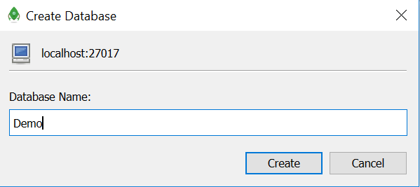
Creating a Database
Creating a database is done using the GUI
Right click on New Connection and select Create Database

Slide 36
Creating Collection and Inserting Values
Create collection
Inserting values
Collection name
db.createCollection('people')
db.getCollection('people')
.insert({
firstName: 'Michael',
lastName: 'Smith',
email: 'michael@gmail.com',
})
Data is inserted as JSON object

Slide 37
Retrieve Entries
Get all entries from a collection
Filter elements by given criteria
Return specified field
db.getCollection('people').find({})
db.getCollection('people').find({ firstName: 'Michael' })
db.getCollection('people').find(
{ firstName: 'Michael' },
{ firstName: 1 }
)
Will retrieve an entity with the desired field only

Slide 38
Updating Entries
Update first entry
db.getCollection('people').update(
{ firstName: 'Anne' },
{ firstName: 'George' }
)
Old value
New value
db.getCollection('people').update(
{ firstName: 'Anne' },
{ firstName: 'George' },
{ $multi: true }
)
Updates all entries with the given value

Slide 39
Deleting Entries
Delete the first entry that matches given criteria
Delete all entries that match given criteria
db.getCollection('people').deleteOne(
{ firstName: 'George' }
)
db.getCollection('people').deleteMany(
{ firstName: 'George' }
)

Slide 40

Summary
…
…
…
Relational Database Management System (RDBMS) store and manage data
We communicate with the DB engine via SQL
MySQL is a multiplatform RDBMS using SQL
NoSQL Databases are more scalable
MongoDB stores entries in JSON format

Slide 41
https://softuni.bg/courses/technology-fundamentals

Slide 42













SoftUni Diamond Partners

Slide 43




SoftUni Organizational Partners

Slide 44




Trainings @ Software University (SoftUni)
Software University – High-Quality Education and Employment Opportunities
softuni.bg
Software University Foundation
http://softuni.foundation/
Software University @ Facebook
facebook.com/SoftwareUniversity
Software University Forums
forum.softuni.bg

Slide 45

License
This course (slides, examples, demos, videos, homework, etc.) is licensed under the "Creative Commons Attribution-NonCommercial-ShareAlike 4.0 International" license

